Slide 1
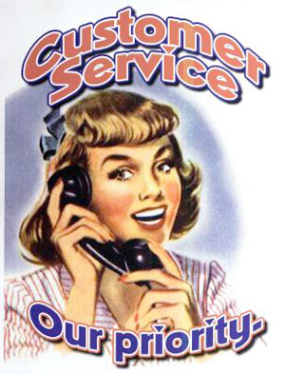
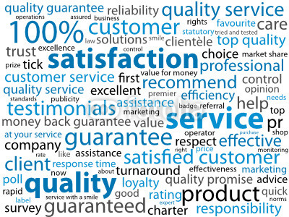
How to be a CSR for a Telecommunications Provider

Slide 2
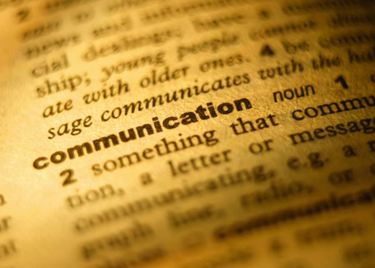
How would you define your Company?
You are not a telephone company anymore
Landline
Internet
Wireless
You are now a Communications Company

Slide 3
6 Steps to Basic Customer Service
Positive Attitude
Know your Products
Listen to the Consumer
Maintain Communication
Solve the Problem
Always Follow Up

Slide 4
6 Steps to Basic Customer Service

Slide 5
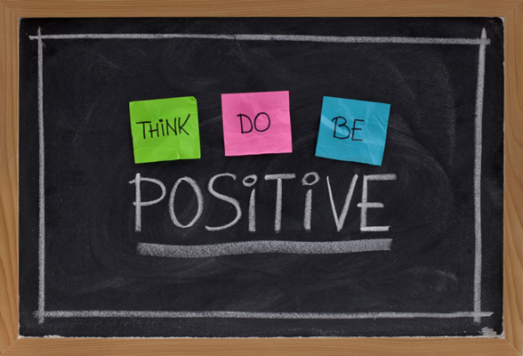
1- Have a positive Attitude
Be polite and enthusiastic
Lack of politeness is a negative
Its not my job
Professional and energetic
Talk Clearly and Slowly
The more complicated the topic the more slowly you need to speak
You do not need to love your Job but you need to like it
If you have ill feelings towards your job you are doing an disservice to your employer, coworkers, family and friends

Slide 6
6 Steps to Basic Customer Service
Positive Attitude
Know your Products
Listen to the Consumer
Maintain Communication
Solve the Problem
Always Follow Up

Slide 7
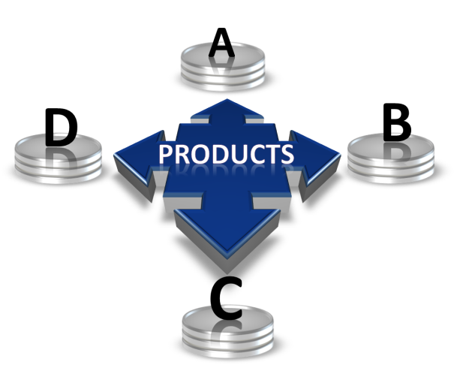
2 – Know your Products
Product Training is very important, keep up to date http://www.cctelco.org/
Important selling points for clients
Talk with your peers
Know your manuals, policies, and procedures

Slide 8
6 Steps to Basic Customer Service
Positive Attitude
Know your Products
Listen to the Consumer
Maintain Communication
Solve the Problem
Always Follow Up

Slide 9
3 – Listen to the Consumer

Slide 10
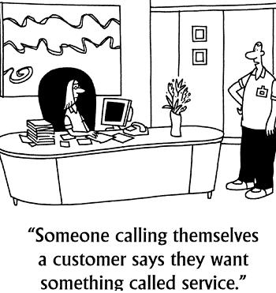
3 – Listen to the Consumer
Do not cut people off
Allow them to finish
Allow them to vent
Listen the WHOLE story
Ask questions if you do not understand when they are finished
take notes
Summarize
Repeat what they said back to them

Slide 11
6 Steps to Basic Customer Service
Positive Attitude
Know your Products
Listen to the Consumer
Maintain Communication
Solve the Problem
Always Follow Up

Slide 12
4 – Maintain Communication
Contact Consumer Immediately

Slide 13
6 Steps to Basic Customer Service
Positive Attitude
Know your Products
Listen to the Consumer
Maintain Communication
Solve the Problem
Always Follow Up

Slide 14
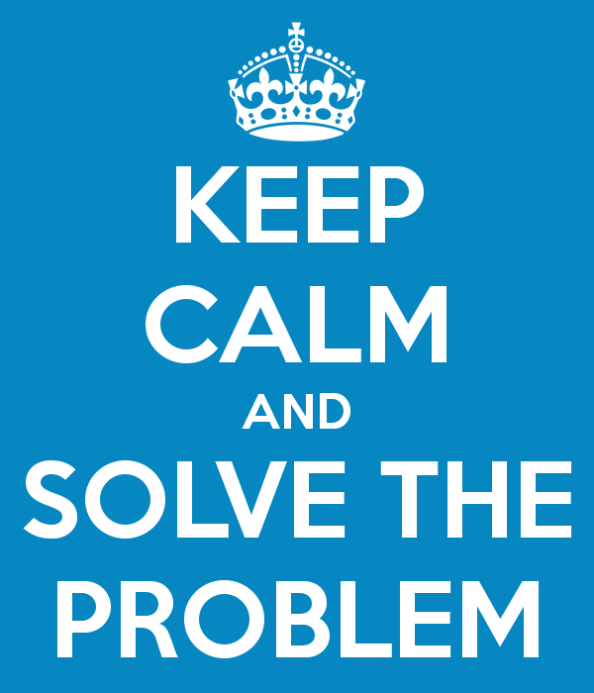
5 – Solve the Problem
Do not quit
Do anything you can to help the customer
Do not push off the customer when otherwise occupied
Customer comes first!
A solved problem equals a happy customer

Slide 15
6 Steps to Basic Customer Service
Positive Attitude
Know your Products
Listen to the Consumer
Maintain Communication
Solve the Problem
Always Follow Up

Slide 16
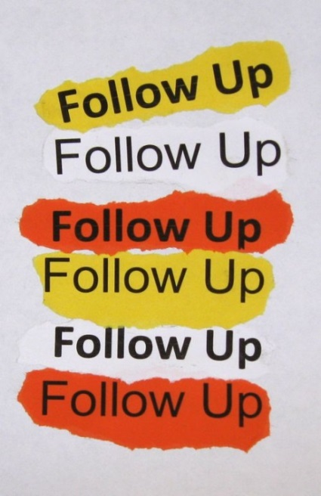
6 – Always Follow up
Most important step!
Extra care and attention
Best Advertising is word of mouth
A cared for customer will spread good words

Slide 17
6 Steps to Basic Customer Service
Positive Attitude
Know your Products
Listen to the Consumer
Maintain Communication
Solve the Problem
Always Follow Up

Slide 18
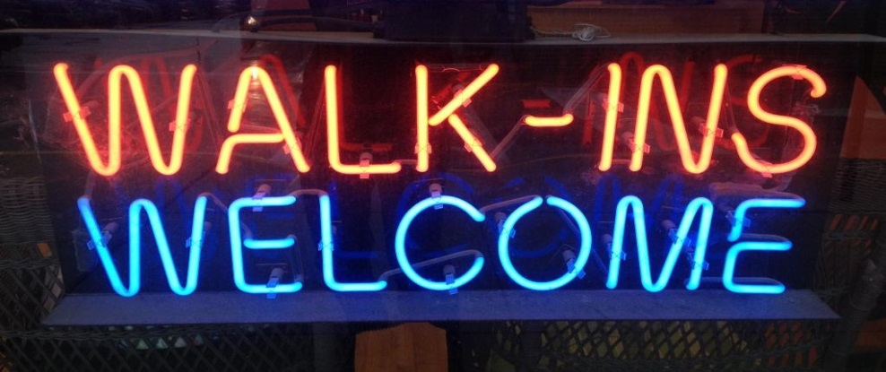
Other Important Parts of being a CSR
Walk-ins
What typically Happens?
How can we correct this?
Ask what they need
Remember 6 steps for good customer service, you work for them

Slide 19
Other Important Parts of being a CSR
Why Customer Service?
Customer Loyalty is KEY
YOU are tied directly to the services that customers obtain from your company
1 good experience is passed on to 5 people
1 bad experience is passed on to 10
Social Media helps this happen
Do not discuss work or customers on social media, you NEVER know who can see it

Slide 20
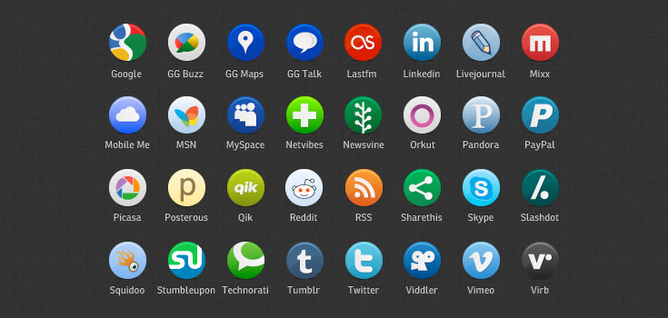
Other Important Parts of Being a CSR
Todays Consumer is controlled by demographics and technology
- Work - Home
You must sell them this experience

Slide 21
Enhance the services already purchased by the customer
Listen to what they have to say (step 3)
Remember and refer to your notes
This allows you to make connections to other products and services that might benefit the customer
Equals more sales
Make customer happy if they paying for something they do not need and you recognize and remedy this
Know the products (step 2)
Its all connected!

Slide 22
Be yourself!
This is very important
You were hired for this position for a reason
You have wonderful qualities to offer your customer and your company
Let them shine through!

Slide 23
Dodie North, GVNW dnorth@gvnw.com

