Slide 1
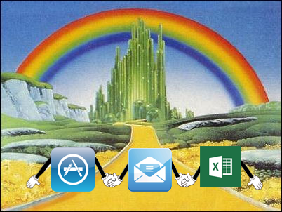

Email, Excel and Apps,
Oh My!!

Slide 2
Technology Update
Excel
Making Office yours
  Recoverable Work
  Ribbon
Comparison between Office versions
Email
Apps
What’s on the horizon?

Slide 3
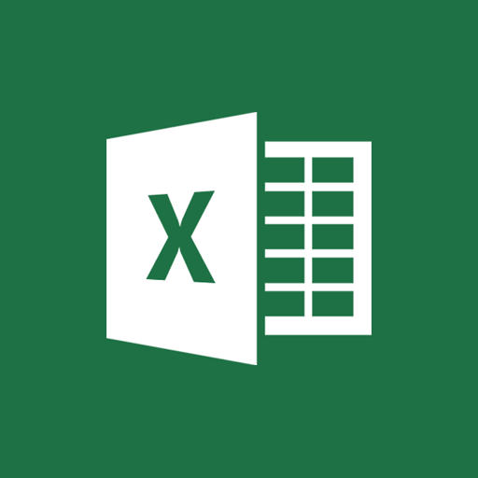
Excel Dual Instances
This is only for Office 2010 and previous, in Office 2013 this has been fixed.

Slide 4
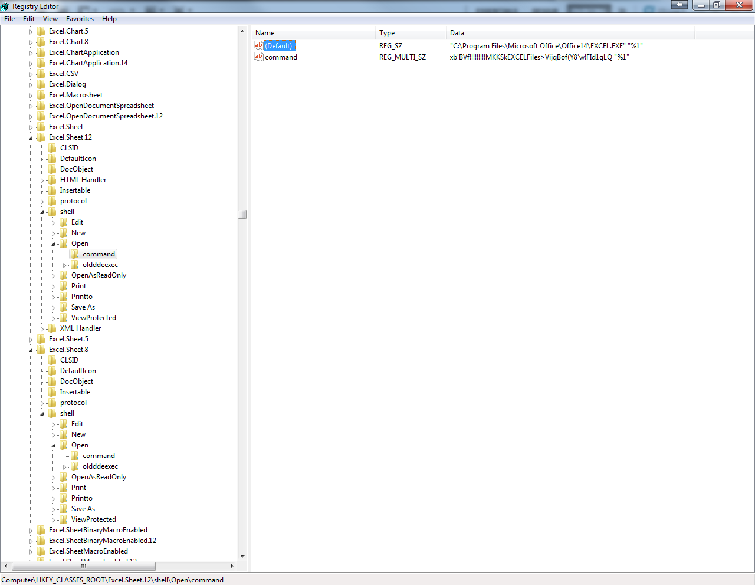

Slide 5
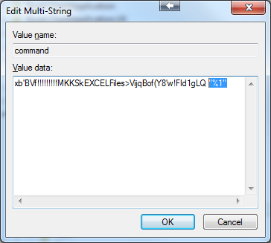
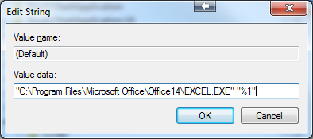
HKEY_CLASSES_ROOT\Excel.Sheet.(8 & 12)\shell\Open\command
Add “%1” to the end of each string to allow dual instance of Excel to occur.

Slide 6
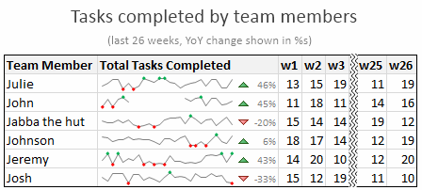
Creating Sparklines
What are Sparklines? A small chart that is aligned with rows of tabular data and usually shows trend information.
How to create sparklines in Excel 2010:
Creating sparklines in excel 2010 is very easy. You follow 3 very simple steps to get beautiful sparklines in an instant.
Select the data from which you want to make a sparkline.
Go to Insert > Sparkline and select the type of sparkline (you have 3 options – line, column and win-loss chart)
Specify a target cell where you want the sparkline to be placed
Optional: Format the sparkline if you want.

Slide 7
Creating and editing PivotTables
Excel 2010 and greater makes it easier to create and edit PivotTables.
http://office.microsoft.com/en-us/excel-help/create-or-delete-a-pivottable-or-pivotchart-report-HP010089893.aspx#_Toc263767342
PivotTable Sample:
http://www3.wabash.edu/econometrics/EconometricsBook/Chapters/Ch03PivotTables/ExcelFiles/EastNorthCentralFTWorkers.xls
Slicers in 2010 allow you to edit Pivot Tables down even more.
http://www.addictivetips.com/microsoft-office/excel-2010-insert-slicer-in-pivot-tables-charts/

Slide 8
Make Office Work for You
Modify the Ribbon
Add a custom tab to the ribbon
Rename a default or custom tab on the ribbon
Hide a default or custom tab on the ribbon
Change the order of tabs
Live Example*
http://office.microsoft.com/en-us/excel-help/customize-the-ribbon-HA010355697.aspx?CTT=5&origin=HA010369709#_Toc323203875

Slide 9
Office Comparisons
Office 2010, 2013 (one time purchase)
  Home & Student
  Home & Office
  Office Professional
Office 365 (monthly subscription)
  Home
  Office
  University

Slide 10


Office Versions | 365 Home | 365 Personal | 365 University | Home & Student 2013 | Home & Business 2013 | Professional 2013
Purchase Options | $9.99 per mo | $6.99 per mo | $79.99 for 4 years | $139.99 | $219.99 | $399.99
Installations
Install Options | 5PCs or Macs, 5 Tablets | 1PC or Mac, 1 Tablet | 2 PC’s Macs or Tablets | 1 PC | 1 PC | 1 PC
Smartphone Android, iPhone, Windows Phone
Online Storage 7GB Free | 20GB Extra for up to 5 users | 20 GB Extra for up to 1 user | 20 GB Extra for up to 1 user
Skype | 60 World Min – 1 user | 60 World Min – 1 user | 60 World Min – 1 user
Always up to Date and free Tech Support

Slide 11

E-mail for Business
Hosted vs Exchange
  Pros & Cons
Mobile
  Ways to use email when away
Security
  Protecting data and messages

Slide 12
Hosted vs Exchange
As cost of server up keep, power consumption, price of onsite or in house Network Admin costs continue to rise many companies are looking at hosting as an option for their Exchange email services.
Depending on how it is hosted you will either be in a lump group and have to go by their standards, or you can have a Virtual Machine which will act the same as your own internal exchange server.

Slide 13
Hosted Pros and Cons
*Trick is going to be how it is hosted*
Benefits:
No servers in house to maintain
Automatic OWA/Active Sync
Automatic updates of versions and hot fixes
Licensing no longer an issue to keep up with internally
Cons:
No full control of the system
You don’t control the security
Monthly subscription
Loss of Internet means loss of internal exchange services

Slide 14
Mobile Email
With the advancements in IIS on Exchange Servers more and more businesses are offering mobile email solutions. These allow the end user to stay connected to the flow of email in the office when away and take care of business when away. With Smartphone's and Tablets even working on attachments is made easy, thus creating an environment where more work is done mobile than ever it was in the past.
Google for example provides businesses with mobile solutions with their global email and data storage.

Slide 15
Mobile Options
IIS and Hosted Exchange Options
OWA
ActiveSync
MS Office 365
One Drive
Other Providers
Google Apps for Business

Slide 16


Email Secure Attachments with a client Portal
ShareFile
Attachments are uploaded to ShareFile
Office Email
Client\Customer
Send a file via email and request a file via email, or upload to a folder where a notification is sent.

Slide 17
Apps
Microsoft Office Mobile
  Works with One Drive and SharePoint online data storage and sharing
World Lens - Free
  https://itunes.apple.com/us/app/word-lens/id383463868?mt=8
Dropbox Mail - Free
  http://www.mailboxapp.com/
Hip Chat – Free to $2 per user/per month
  https://www.hipchat.com/
Trello – Collaboration and Planning tool
  https://trello.com/

Slide 18
Microsoft Office
Cloud – With your phone, you can access Office documents stored on OneDrive, OneDrive for Business, or SharePoint.
Recent Documents – Office Mobile is cloud-connected. The documents you’ve recently viewed on your computer are readily available on your phone in the recent documents panel.
Email Attachments – You can view and edit Office documents attached to email messages.*
Make quick edits to Word, Excel & Powerpoint
* Sign in with a free Microsoft account to create, edit and save documents for home use. A qualifying Office 365 subscription is required to create, edit and save documents for business use. Qualifying plans include:
•Office 365 Small Business Premium
•Office 365 Midsize Business
•Office 365 Enterprise E3 and E4 (Enterprise and Government)
•Office 365 Education A3 and A4
•Office 365 ProPlus

Slide 19

World Lens

Slide 20
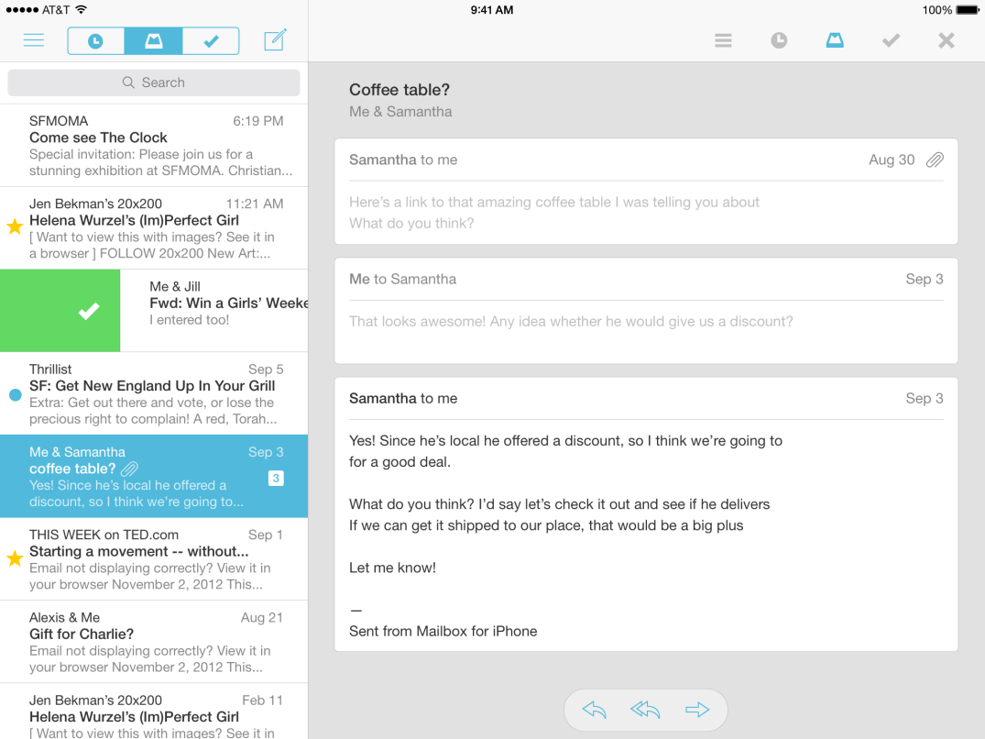
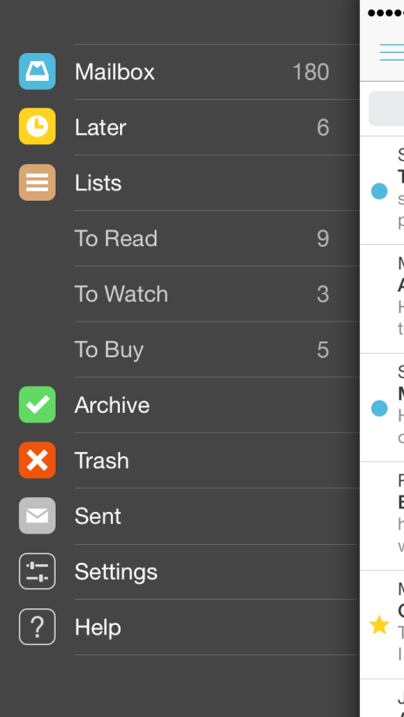
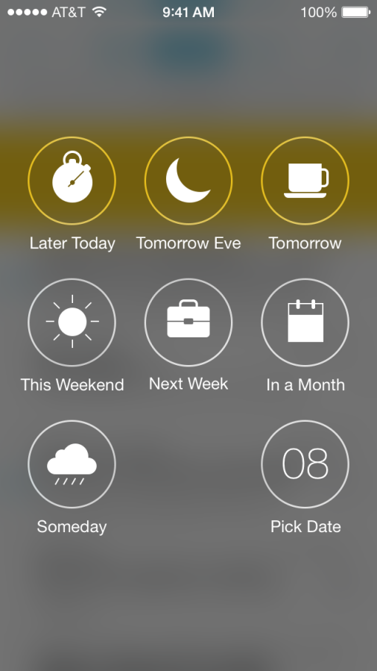

MailBox (Drop Box Email)
Take charge of email and focus on the emails that matter and save for later the ones that don’t with a simple swipe.

Slide 21
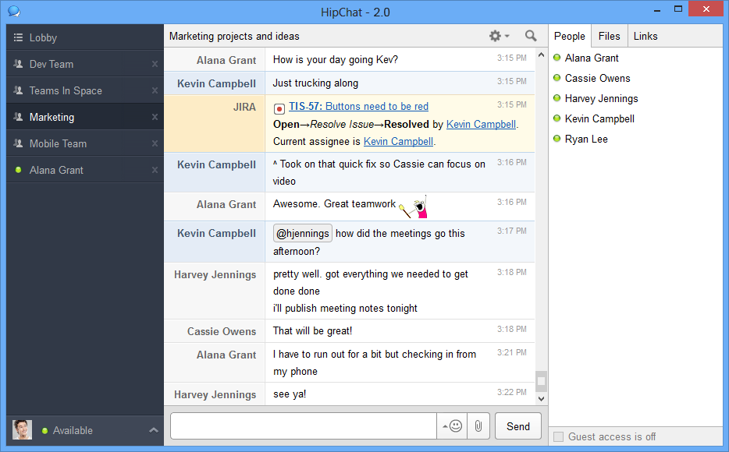
Hip Chat
Collaboration/Support Tool
Group Chat and IM
1 to 1 Video Chat & Screen Sharing
File Storage (5GB Free, Unlimited $2)
Searchable message history

Slide 22
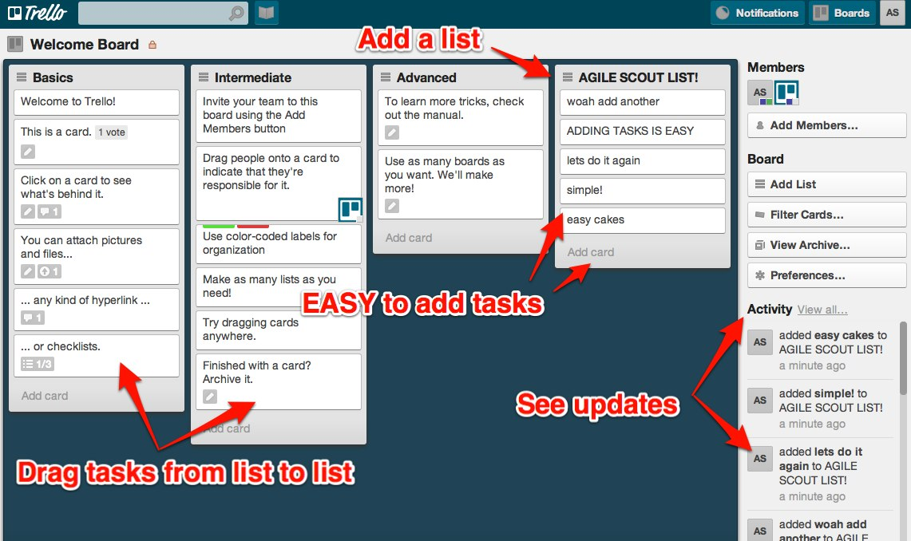
Trello
Setup Assignments
Collaborate
Assign/Re-assign projects and tasks on the fly
Simple Bulletin Board Card view for easy identification of the step by steps in a project

Slide 23
I've got you now my pretty….
Start menu on desktop for Windows 8 will not be arriving until 2015 with Windows 9.
Win XP users are being targeted by hackers now that Microsoft has officially left its flagship OS in the dust
  Ways you can minimize risk:
    Do Not use IE, upgrade to security based browsers such as Google Chrome or Mozilla
    Disable Java and Flash add-ons in other browsers
    Install Firewall software\hardware
    Keep Antivirus & Spyware\malware software updated
    Place XP machines on separate network with their own firewall

Slide 24

What’s behind the curtain?

Slide 25
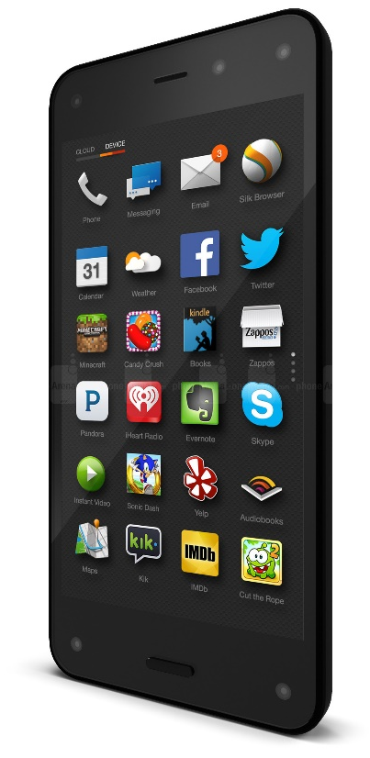
The Wizard has some things for you.
Large capacity SSD Drives at an affordable price
  Samsung 840 EVO 1TB SSD for $400
Amazon Fire Phone
  Firefly uses the rear camera to identify objects and phone numbers.
  Dynamic Perspective uses some forward-facing infrared cameras to track your head, and then alters the phone’s display to give a 3D effect.

Slide 26
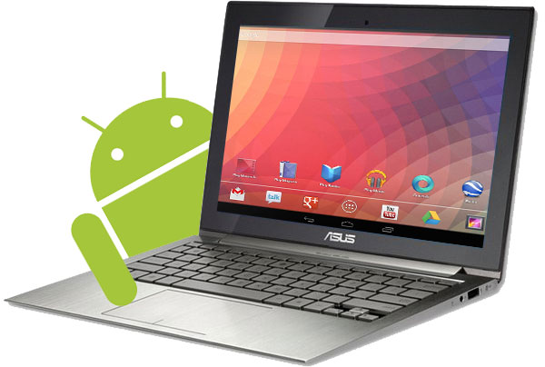
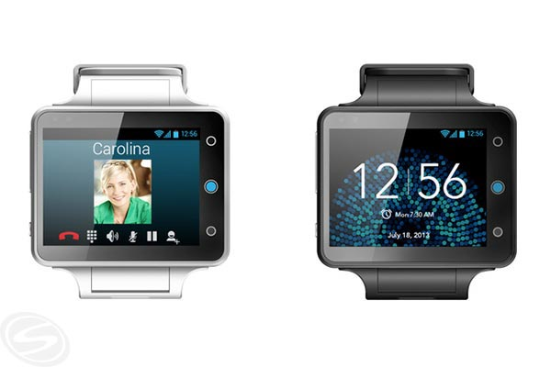

Android Netbooks
Android enters the netbook market as a
competitor to Chrome.
SmartWatches
SmartWatches continue to become a
popular extension of smartphones.
802.11ac & ax (Runs on 5Ghz channel)
802.11ac offers up between 1.7Gbps and
2.5Gbps speed (out a year already)
802.11ax offers up between 7Gbps and
10Gbps speed (certification in 2018)

Slide 27
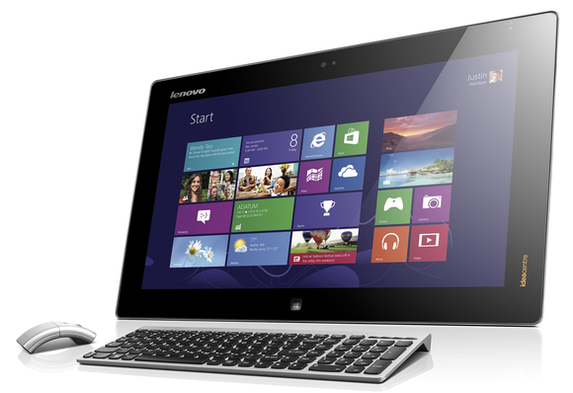
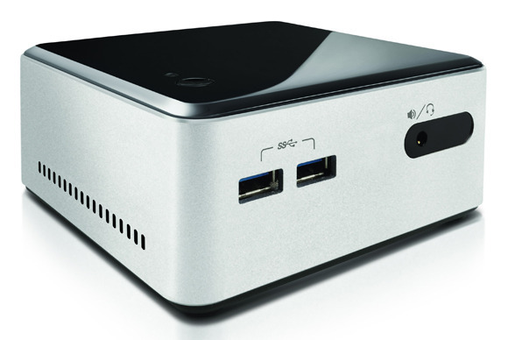
Future of the laptops & desktops
Desktops will face a size & mobility change as industries still fight to keep data locked down by keeping their equipment less mobile than a laptop or tablet.

Slide 28
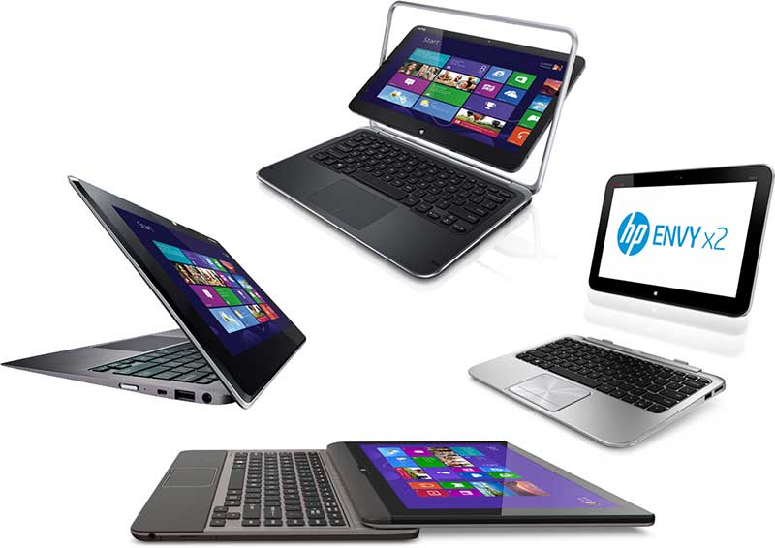
Future of Laptops
Future of laptops are tablets and hybrids. Less weight and more laptop like functionality.

Slide 29
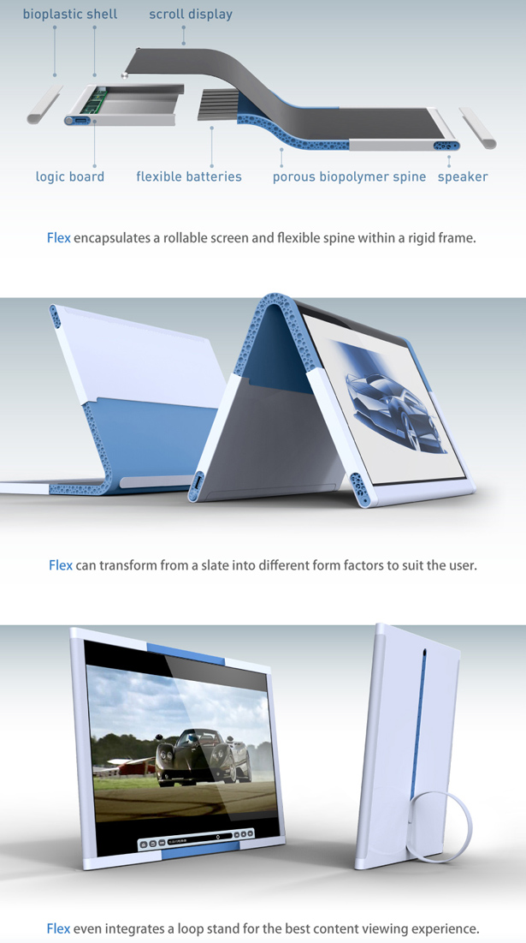
Tablet futures seem to be facing a bit of a curve
The future of the tablet is a bit flexible. With more and more patents being launched for flexible electronics we may be seeing a “curve” in the tablet market.

Slide 30
Links
Sperry Software – safeguard email send
  http://www.sperrysoftware.com/Outlook/Safeguard-Send.asp
Office 2013
  http://office.microsoft.com/en-us/excel-help/what-s-new-in-excel-2013-HA102809308.aspx?CTT=5&origin=HA102830213
Office 2010
  http://office.microsoft.com/en-us/excel-help/what-s-new-in-excel-2010-HA010369709.aspx#_Toc274394081
Protect from crash & Recover an earlier version of an Office File
  http://office.microsoft.com/en-us/excel-help/recover-an-earlier-version-of-an-office-file-HA010356735.aspx?CTT=5&origin=HA010369709

Slide 31

There’s no place like 127.0.0.1
Thank You!

