Slide 1
_______________________________________________ Individual Federal Tax Update
TSTCI Accounting and Customer Service Conference
July 9, 2014
Presented by:
Dirk D. Coleman, CPA
Curtis Blakely & Co., P.C.
P.O. Box 5486
Longview, TX 75608
(903) 758-0734
dcoleman@cbandco.com
Prepared by: Brittany McCloskey, CPA
and Dirk Coleman, CPA
Notes:
Hello. My name is Dirk Coleman, and I’m with Curtis Blakely & Co. I want to thank you for the opportunity to speak with you today.
We are in unusual times, with so may of the tax laws scheduled to expire or significantly change. It is expected that Congress will take action to extend many of these provisions, but no one is sure yet when and how significant the changes will be. Today, we will discuss the possible tax law changes and how it will affect you in these times of uncertainty.

Slide 2
Disclaimer
The material contained in this presentation is for informational purposes only and is not legal or accounting advice. Communication of the information is not intended to create, and receipt does not constitute, a legal relationship, including but not limited to an accountant-client relationship. Although these materials may have been prepared by professionals, they should not be used as a substitute for professional services. If legal, accounting or other professional advice is required, the services of a professional should be sought.

Slide 3
Objectives
Consider Economic Environment
Discuss Estate and Gift Tax
Review Income Tax Law Changes for
2013 and 2014
Explore tax reform ideas

Slide 4
The Current Environment

Slide 5
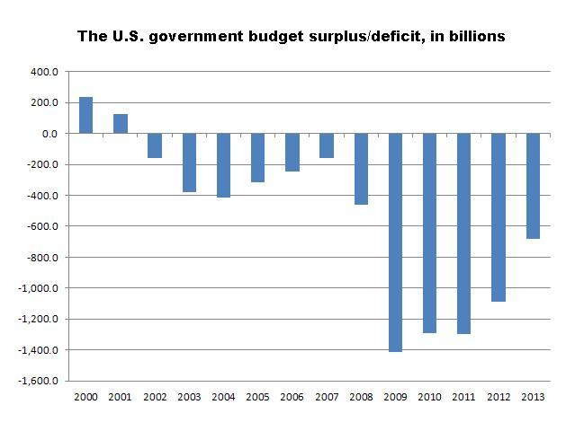
The Current Environment
Source: Congressional Budget Office, Treasury Department

Slide 6
The Current Environment
FY 2013 Budget Deficit Figures
Tax Revenue: | $ 2,774,000,000,000
Spending: | $ 3,454,000,000,000
New Debt: Current: | $ 680,000,000,000 (4.1% of GDP)
Total Debt: | $17,552,000,000,000 (as of 6/26/2014)
GDP: | $16,789,000,000,000 (as of 6/26/2014)
Debt/GDP: | 104.55% (as of 6/26/2014)
www.usdebtclock.org

Slide 7
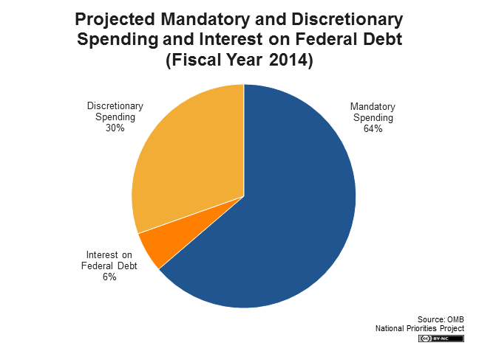

Slide 8
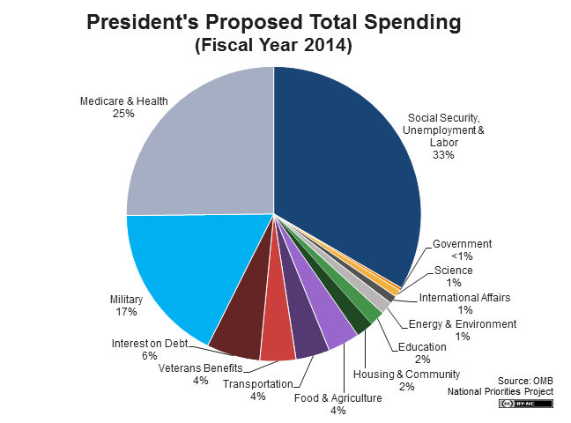

Slide 9
Tax Policy Center 2013 Statistics
Cash Income
$20,113
$39,790
$64,484
$108,266
0%
20%
40%
60%
80%
100%
-3.0%
4.2%
-1.1%
9.9%
6.4%
14.9%
13.9%
20.0%
83.8%
51.5%
Percentage of Individual Income Tax Paid
Percentage of Cash Income
Quintiles calculated on number of people, not tax units
Uses current law baseline

Slide 10
Tax Policy Center 2013 Statistics
Cash Income
Top 20% Income, 90.5% Income Tax Paid Breakdown
$108,266
$143,373
$204,296
$506,210
80%
90%
95%
99%
100%
12.3%13.4%
9.5%
8.7%
18.5%
12.1%
43.4%
17.4%
Percentage of Individual Income Tax Paid
Percentage of Cash Income
Quintiles calculated on number of people, not tax units
Uses current law baseline

Slide 11
Estate and Gift Tax

Slide 12
Estate and Gift Tax
Estate and Gift Exemption (indexed for inflation)
2011 - $5,000,000
2012 - $5,120,000
2013 - $5,250,000
2014 - $5,340,000
Gift Tax Annual Exclusion
2013 – $14,000
2014 – $14,000
Portability Election
Carryover “Deceased Spouse Unused Exemption” – DSUE
Must file a Form 706 – Estate Tax Return
Helps simplify estate planning for smaller estates

Slide 13
Estate and Gift Tax
Review estate planning documents
Old documents could result in unintended outcomes
Flexibility is important
Check beneficiary designations
Check brokerage and bank account ownership
Joint Tenant with Right of Survivorship
Pay on Death (POD)
Plan for real estate owned outside Texas (avoid probate)
Gift prior to death (drawback is carryover basis versus step-up)
Transfer assets to an LLC

Slide 14
2013 Highlights
Sources: Steven J. Tillinger, CPA. “Federal Tax Update.” Fort Worth Chapter, TSCPA

Slide 15
Changes that took effect in 2013
January 2, 2013 - the President signed legislation making permanent most of the previous twelve years of temporary tax provisions.
The 10%, 15%, 25%, 28%, 33% and 35% marginal income tax rates were made permanent.
(Indexed for inflation)
For 2013, a new 39.6% marginal tax rate

Slide 16
Changes that took effect in 2013
Medical Care Itemized Deduction Threshold
Prior law – Medical expenses > 7.5% of AGI
New law – Medical expenses > 10% of AGI.
Exception – Retains prior law for 2013 - 2016, if either the taxpayer or the taxpayer’s spouse turns 65 before the end of the taxable year

Slide 17
Changes that took effect in 2013
Itemized Deductions Limitation (High-Income taxpayers)
Deductions reduced by 3% of amount by which taxpayer’s AGI exceeds threshold
A taxpayer will receive at least 20% of itemized deductions
Exceptions
Medical Expenses
Investment Interest Expense
Casualty or theft losses
Affects the TOP 5% of taxpayers

Slide 18
Changes that took effect in 2013
Itemized Deductions Limitation (Example):
Married Filing Joint
AGI is $350,000
Threshold for 2013 is $300,000
AGI exceeds threshold by $50,000
Result: Itemized deductions are reduced by $1,500 (3% x 50,000)

Slide 19
Changes that took effect in 2013
Personal Exemption phase-out
Old Law restored, but with higher thresholds
Personal exemption ($3,900 for 2013) phased out over the following AGI thresholds:
$300,000 for married couples
$250,000 for single taxpayers
$275,000 head of household
$150,000 married filing separately

Slide 20
Changes that took effect in 2013
New Tax Rates on Dividend Income and Capital Gains:
Capital Gain and Dividend Rates: 0%, 15%, & 20%
20% rate applies to filers in the 39.6% marginal bracket
Married Filing Jointly – 2013
0
17,850
72,500
146,400
223,050
398,350
450,000
10%
15%
25%
28%
33%
35%
39.6%
Marginal Income Tax Brackets
0%
15%
20%
Capital Gain and Qualified Dividend Tax Rates

Slide 21
Changes that took effect in 2013
Home Office Safe Harbor Alternative:
Actual costs vs. Safe Harbor (annual election)
Simplified calculation: $5 per square foot of space used exclusively for business.
Maximum 300 sq. ft. – (equivalent to a room a little larger than 17’ x 17’)
The maximum deduction is $1,500
Available for 2013 and subsequent years
Taxpayers using this simplified method can claim all of their allowable mortgage interest and real estate taxes on Schedule A.
Sources: The Kiplinger Washington Editors, Inc. The Kilplinger Tax Letter. Vol.89, No. 2

Slide 22
Changes that took effect in 2013
Medicare Contribution Tax – Individuals, Trusts, and Estates
Two new taxes from 2010 Affordable Care Act:
0.9% tax on earned income over $250,000 (MFJ), and
3.8% tax on certain unearned income (Net Investment Income) over the same threshold
Threshold is NOT indexed for inflation

Slide 23
Medicare Contribution Tax (cont.)
Net Investment Income is the sum of:
Category 1 – Investment Income
Interest
Dividends
Annuities
Rents
Royalties
Category 2 – Passive Activities
Category 3 – Net Gains (but not Net Loss)
Capital Gains
Less allowable deductions properly allocable to such income or gain
Sources: Blaise C. Bender, PC. Federal Tax Update. East Texas Chapter, 2014.

Slide 24
Medicare Contribution Tax (cont.)
Net Investment Income does NOT include:
Active income in partnerships and S corporations
Amounts subject to self-employment tax
Tax-exempt interest
Social Security benefits
Life insurance proceeds
Gifts and Inheritances
Distributions from qualified employee benefit plans or arrangements (401(k) and IRAs)
Alimony
Excluded gain from the sale of a principal residence
Items which are otherwise excluded from gross income

Slide 25
Medicare Contribution Tax (cont.)
The 3.8% Medicare tax is imposed on the lesser of an individuals:
Net Investment Income; or
Modified AGI in excess of
$250,000 for joint filers and surviving spouses
$125,000 for a married taxpayer filing separately
$200,000 in any other case
If a couple files jointly and their combined AGI is less than $250,000, they will not pay the 3.8% Medicare tax.

Slide 26
Medicare Contribution Tax (cont.)
How do these laws affect you?
95% of all taxpayers will see no change in their tax liability!
(For Now!)

Slide 27
Tax Filing Season - IRS

Slide 28
Tax Filing Season - IRS
What to expect for the 2013 Tax Filing Season
2013 IRS budget - $526 million smaller than the original budget because of sequestration cuts.
2013 Government shutdown
Effects:
Delayed filing season until Jan. 31
Provides the IRS time to program and test its tax processing systems
IRS is struggling on the enforcement front
Don’t expect much in the way of service from the IRS
Sources: The Kiplinger Washington Editors, Inc. The Kiplinger Letter. Vol. 89, No. 3.

Slide 29
Tax Filing Season – IRS (cont.)
What to expect for the 2013 Tax Filing Season (cont.)
Good News
2013’s overall individual audit rate fell to 0.96%
2.7% exam rate for $200K to $1M income
10.85% exam rate for > $1M income
It is expected to sink even lower for 2014 as the agency’s resources continue to shrink.
Bad News
Don’t expect much service from IRS
Need help with complicated tax questions? You’re out of luck!
Cut training budget by 87%
IRS responded timely only 47% of the time
61% chance of speaking to a LIVE person!

Slide 30
Tax Filing Season – IRS (cont.)
IRS Service Options
“Taxpayers should be aware that due to limited resources, individualized tax help on IRS toll-free lines and Taxpayer Assistance Centers has changed beginning this year.” (IRS Tax Tips – 1/30/14)
The quickest way to get info is through IRS.gov
Bookmark http://www.irs.gov/Individuals/1040-Central for tax help
Download Tax forms and Publications
Use the Interactive Tax Assistant to answer questions
Find out if you’re eligible for the Earned Income Tax Credit
Track your refund using “Where’s My Refund?” tool

Slide 31
Tax Filing Season – IRS (cont.)
IRS Audit Red Flags
Making too much Money
Failing to Report All Taxable Income
Taking Large Charitable Deductions
Claiming Rental Losses
Deducting Business Meals, Travel and Entertainment
Claiming 100% Business Use of a Vehicle
Writing off a Loss for a Hobby Activity
Claiming the Home Office Deduction
Taking an Alimony Deduction
Running a Small Business
Failing to Report a Foreign Bank Account
Taking Higher-than-Average Deductions
Sources: The Kiplinger Washinton Editors . IRS Audit Red Flags. 2014.

Slide 32
Tax Filing Season – IRS (cont.)

Slide 33
The Uncertain Outlook
Sources: Steven J. Tillinger, CPA. “Federal Tax Update.” Fort Worth Chapter, TSCPA

Slide 34
The Uncertain Outlook
Expiring Tax Provisions
Healthcare Legislation
Tax Reform

Slide 35
Individual Expiring Tax Provisions
Expired at the end of 2013
Itemized deduction for State and Local Sales Taxes
$250 deduction for teachers’ unreimbursed out-of-pocket classroom-related expenses
Deduction for mortgage insurance premiums deductible as qualified interest.
Exclusion of discharge of principal residence indebtedness from gross income.
Tax-free distributions from IRAs for charitable purposes

Slide 36
Expiring Individual Tax Provisions
Will Congress reinstate?
Likely YES, but when?
Election year politics?
Retroactive to 1/1/13?
Most Likely to be reinstated:
Election to claim an itemized deduction for state and local sales taxes
Above the line $250 deduction for teachers’ unreimbursed out-of-pocket classroom-related expenses
Tax-free IRA distributions for charitable purposes

Slide 37
Expiring Business Tax Provisions
Section 179 expensing –
2012 – up to $500,000 with phaseout at $2,000,000
2013 – up to $500,000 with phaseout at $2,000,000
2014 – up to $25,000 with phaseout at $200,000.
Proposed legislation to extend $500K/$2M thru 2015
Bonus depreciation –
2012 – 100% bonus depreciation
2013 – 50% bonus depreciation
2014 – 0% bonus depreciation
Proposed legislation to extend 50% bonus thru 2015
Research and Development Tax Credit

Slide 38
Healthcare Legislation
What did Congress do in 2010?
Wrote a broad framework for healthcare legislation, and then …
Left it to the various governmental agencies to fill in the blanks
What is happening now?
Governmental agencies (Department of Health and Human Services, Department of Labor, Department of the Treasury - IRS) are writing the law.
Meaning… the law is being written as we go along…
Presidential executive orders used to delay mandates and tweak deadlines
Legal challenges continue

Slide 39
Tax Reform Possibilities
Congress is interested in tax reform
Sen. Ron Wyden (D-OR) new chairman of Senate Finance
No consensus on what “reform” means
Adjust tax rates (individual and/or corporate)?
Broader base?
When? – after mid-term elections
One to three years away
Considerations:
Revenue neutral vs. Raise new revenue
National Sales Tax
National Value Added Tax (VAT)
Flow thru entity reform (S-corp and Partnerships)
Sources: The Kiplinger Washington Editors, Inc. The Kiplinger Letter. Vol. 89, No. 3.

Slide 40
Interested in receiving our newsletter?
Sign up at:
www.cbandco.com

Slide 41
Questions?
Individual Federal Tax Update
Dirk D. Coleman, CPA
Curtis Blakely & Co., P.C.
P.O. Box 5486
(903) 758-0734
dcoleman@cbandco.com

